Slide 1
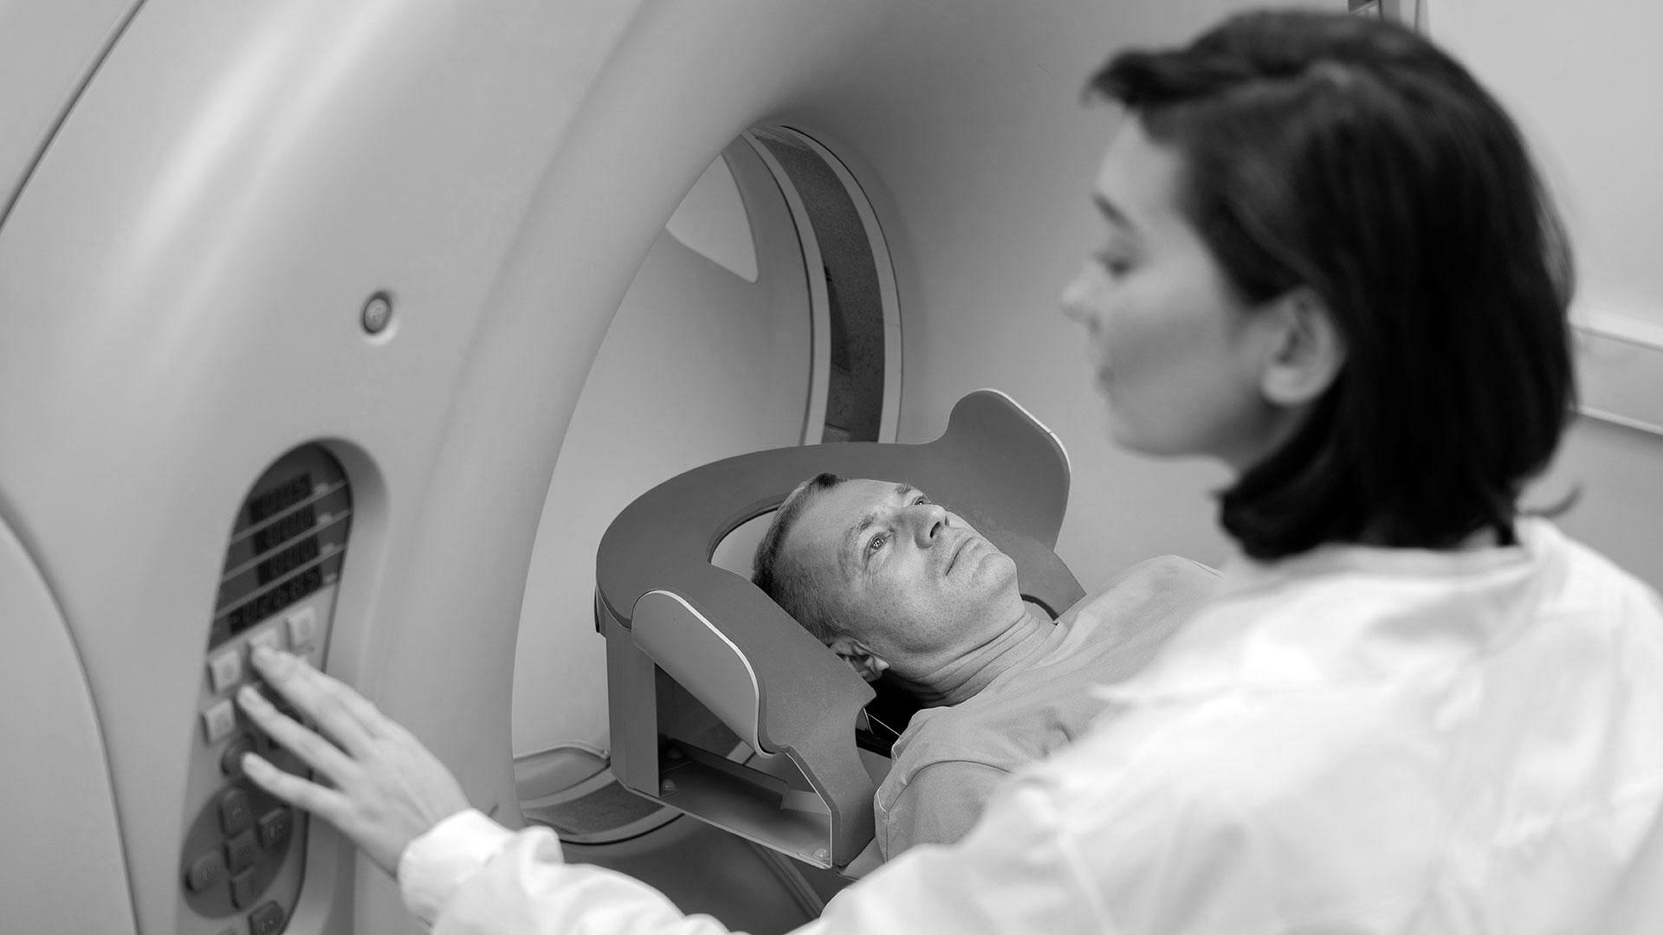
Brain Tumor Detection using CNN

Slide 2



Brain Tumor Detection using CNN
Channabasaveshwara Institute of Technology
(Affiliated to VTU, Belgaum & Approved by AICTE, New Delhi)
(NAAC Accredited & ISO 9001:2015 Certified Institution)
NH 206 (B.H. Road), Gubbi, Tumkur – 572216. Karnataka.
Department of Computer Science and Engineering
2021-2022
Project on
Team members:
Guide:
Dr. Shantala C P Ph.D
Professor & Head
Dept. of CSE
C.I.T, Gubbi
Bharath Kalyan S [1CG18CS017]
Darshan G A [1CG18CS025]
Himagirisha N D [1CG18CS033]
Mahadev [1CG18CS048]

Slide 3
CONTENTS
INTRODUCTION
PROBLEM STATEMENT
OBJECTIVE
SCOPE OF THE PROJECT
LITERATURE SURVEY
EXISTING SYSTEM
PROPOSED SYSTEM
METHODOLOGY
WORK FLOW
DATASET
DATA PRE-PROCESSING
MODEL
CNN
LAYERS OF CNN
EfficentNet-B3
RESULT
CONCLUSION
FUTURE SCOPE

Slide 4
INTRODUCTION
A Brain tumor is considered as one of the aggressive diseases, among children and adults.
Brain tumors account for 85 to 90 percent of all primary Central Nervous System(CNS) tumors.
The best technique to detect brain tumors is Magnetic Resonance Imaging (MRI).
This system takes these MRI’s as input to predict the presence of brain tumor and its type ( either Pituitary or Meningioma or Glioma )

Slide 5
PROBLEM STATEMENT
“At present, brain tumors are detected by imagining only after the onset of the neurological symptoms, and they're not many systems out there to predict the same more accurately using MRIs”.

Slide 6
OBJECTIVE
To develop an automated system for segmentation and classification of brain tumors.
To recognize the Brain Tumour using deep learning and to get better accuracy.
The primary goal of medical imaging projects is to extract meaningful and accurate information from these images with the least error possible.

Slide 7
SCOPE OF THE PROJECT
It can be implemented in recognition of Brain tumour Using MRI scan Image.
The system can be used by neurosurgeons and healthcare specialists
It can be implemented in mobile application So that common people can also Identify if they have tumour or not.

Slide 8
LITERATURE SURVEY
SL. NO. | TITLE | AUTHORS | ALGORITHMS USED | OBSERVATION
1 | Brain Tumor Detection Model from MR Images using Convolutional Neural Network | Dr. Chinta Someswararao, R Shiva Shankar, Sangapu Venkata Appaji and VMNSSVKR Gupta | Convolutional Neural Network (CNN) | In their project it is observed that, even though they have managed to produce a model with significantly high accuracy but the dataset used has only around 100 MRIs.
2 | Brain Tumor Detection and Classification using Convolution Neural Network Models | M. Latha, M. Senthilmurugan and R. Chinnaiyan | Convolutional Neural Network (CNN) , Artificial Neural Network (ANN) and TL. | Brain tumor is classified into Glioma Tumor, Meningioma Tumor or Pituiary Tumor but with lesser classification accuracy.
3 | Brain Tumour Classification using CNN Algorithm | Mandala Jagadeesh, P. Chitra, K. Srilatha, M. Sumathi and I. Rexiline Sheeba | Convolutional Neural Network (CNN) | This system only detects tumours using MRIs with around 90% accuracy.

Slide 9
SL. NO. | TITLE | AUTHORS | ALGORITHMS USED | OBSERVATION
4 | Brain Tumor Detection and Classification Using Convolutional Neural Network and Deep Neural Network | Chirodip Lodh Choudhury, Chandrakanta Mahanty, Raghvendra Kumar and Brojo Kishore Mishra | Deep Learning with Convolutional Neural Network (CNN) | They have implemented a system to classify MRIs into tumorous and Non-tumorous with accuracy of around 96%
5 | Brain Tumor Detection using Deep Learning and Image Processing | Aryan Sagar Methil | Convolutional Neural Network (CNN) and Image Processing Techniques | In this paper they have used some Image Processing Techniques to process the image before training it to the CNN model which resulted in 98% accurate model.
6 | MRI-based Diagnosis of Brain Tumours Using a Deep Neural Network Framework | Milan Acharya, Abeer Alsadoon, Shahd Al-Janabi, P.W.C. Prasad, Ahmed Dawoud, Ghossoon Alsadoon and Manoranjan Paul | Deep Neural Network with Convolutional Neural Network (CNN) | This model only detects the tumour by separates segmenting the tumour part which is around 90% accurate.

Slide 10
EXISTING SYSTEM
It has been observed that the models in the existing systems have used deep learning algorithms and techniques such as Convolutional Neural Network, Artificial Neural Network and some models have used image processing techniques to help their model.
Drawbacks:
There are many systems out there to detect the tumours using MRIs but very few to classify the detected tumour.
Many of these systems were trained on datasets with less number of MRIs which lead to less accurate systems while predicting the tumors.
Some of these systems have good accuracy while predicting the tumour, but they fail to classify they with the same accuracy.

Slide 11
PROPOSED SYSTEM
The proposed system uses a Convolutional Neural Network based algorithm “EfficientNet-B3” which is well known for its simplicity and its performance.
Our system uses reasonably large dataset with more than 3260 MRIs to train model.
The model is capable of detecting the tumours and classify the tumours with high accuracy.
More than 2000 MRIs are used to train the model which in turn will generalize the model to get more accurate classification results.
The model effectively classify the test MRIs either as Glioma Tumour or Meningioma Tumour or Pituitary Tumour or as a Non-Tumour.

Slide 12
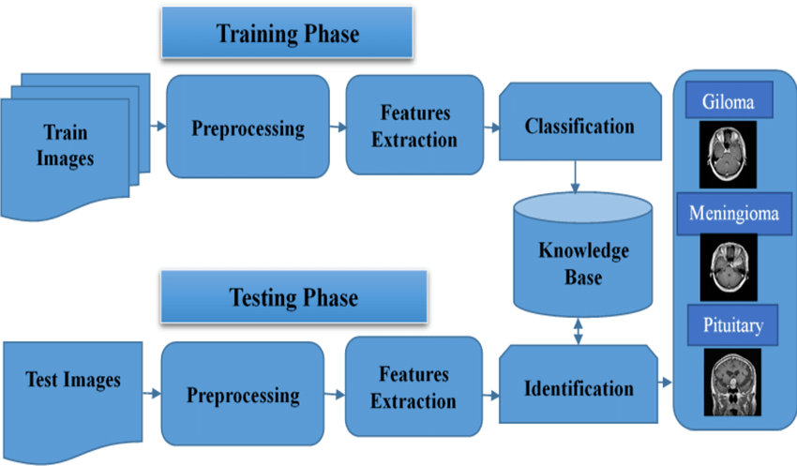
METHODOLOGY

Slide 13
start
WORK FLOW
Import Dataset
Analyze the dataset
Data preprocessing
90% ( 2583 )
Split the data
10% ( 287 )
Train data
Test data
Convolutional Neural Network
Proposed model
Prediction data ( 394 )
Evaluate
Training the model
Fit
Validate Accuracy of the model
Predict
stop

Slide 14
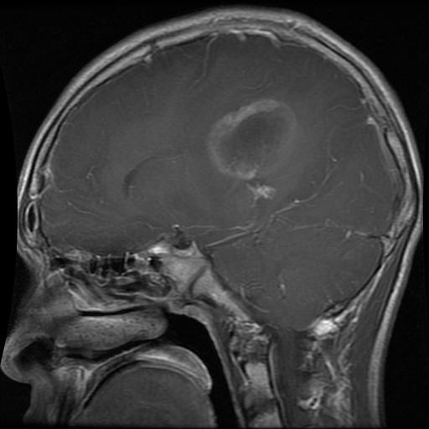
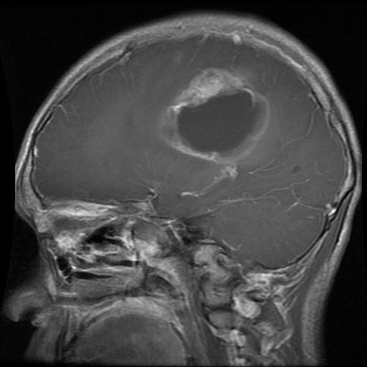
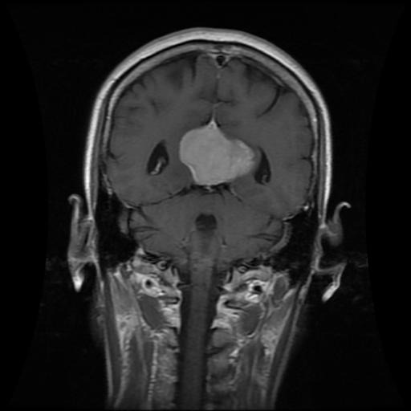
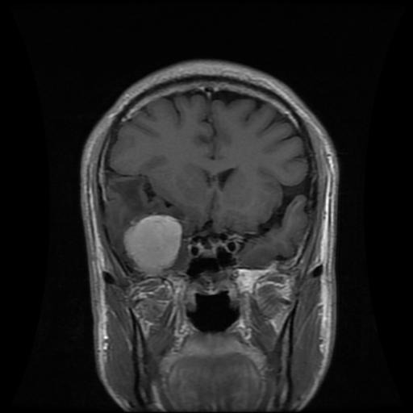
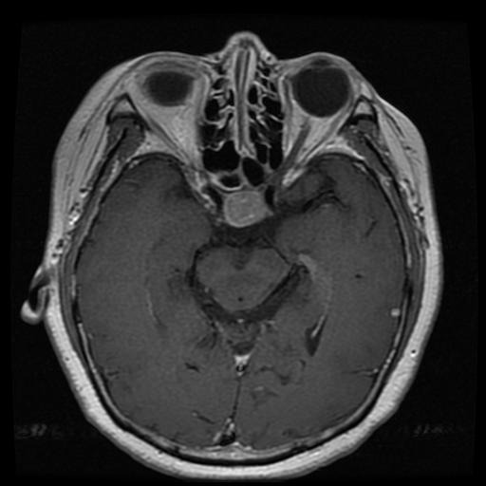
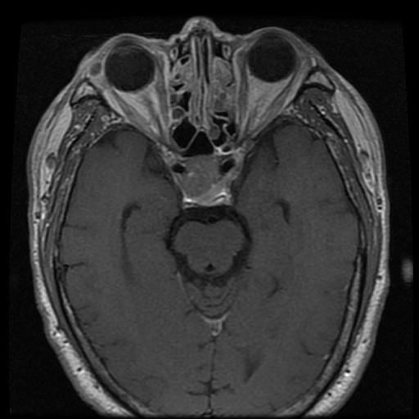
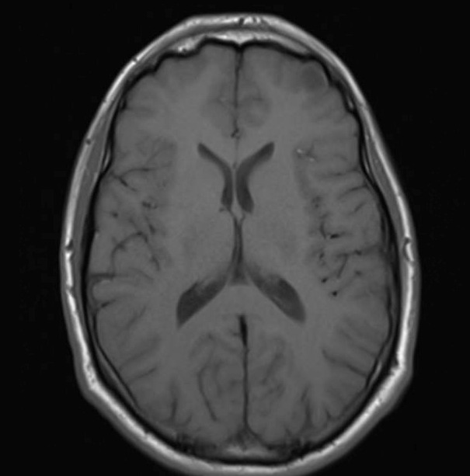
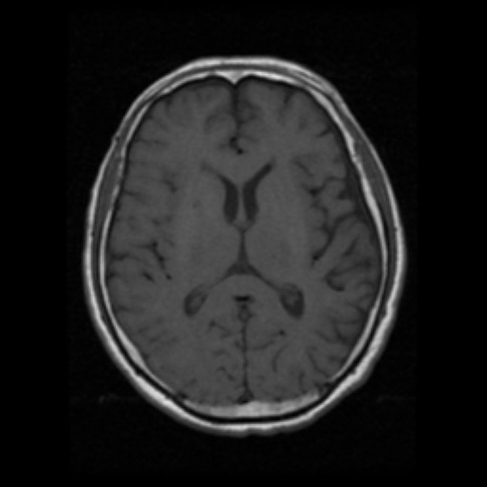
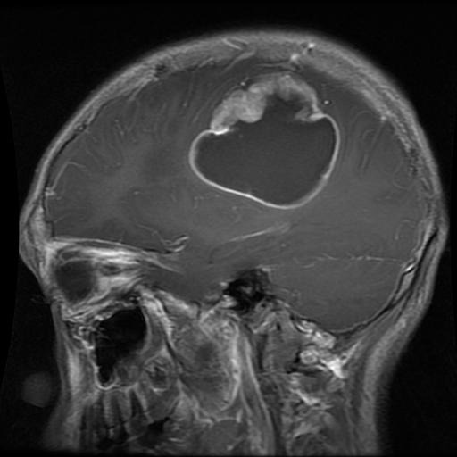
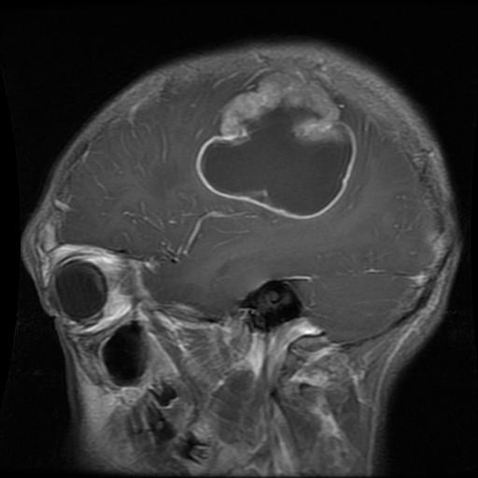
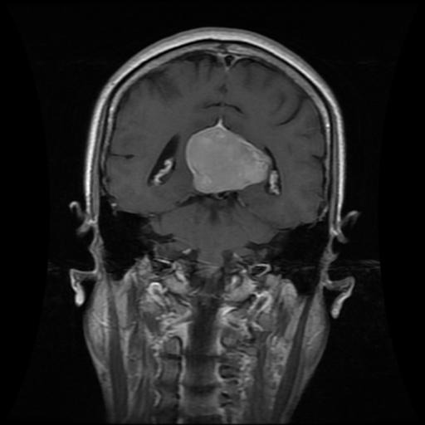
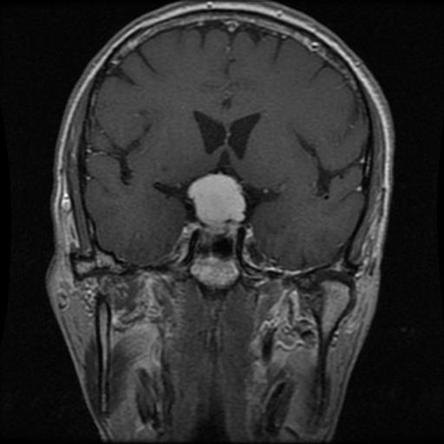
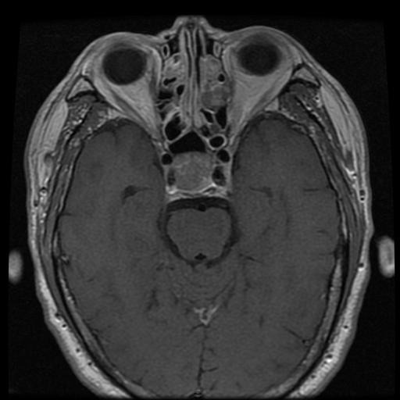
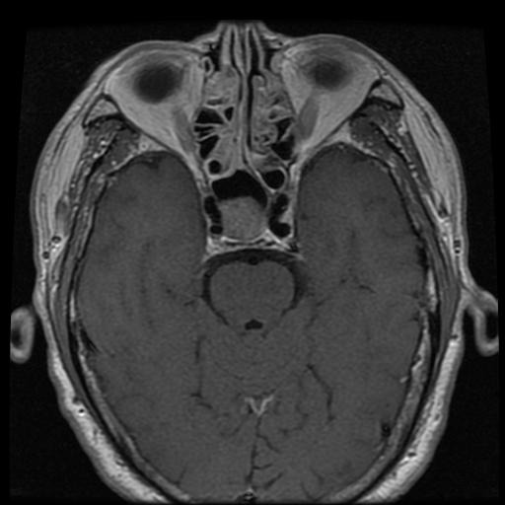
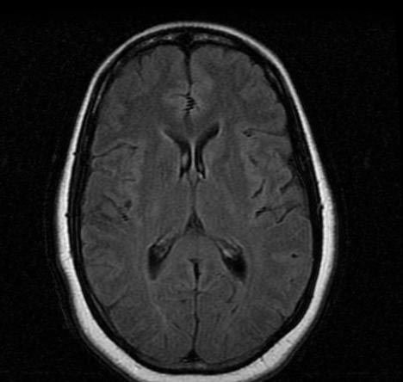
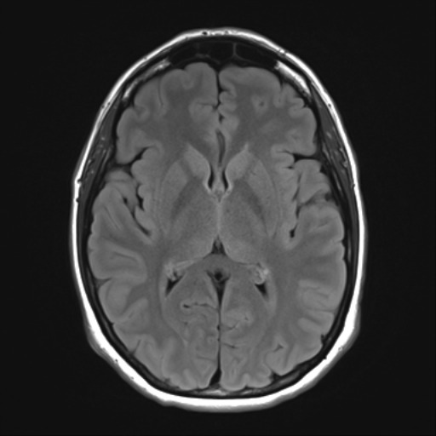
DATASET
Glioma Tumor
Meningioma Tumor
Pituitary Tumor
No Tumor

Slide 15
DATA PRE-PROCESSING
In data pre-processing the MRIs are processed before training the model
Resizing the MRIs.
Merging ‘Training’ and ‘Testing’ folder MRIs.
Data Augmentation.
Rotate
Shift along axis
Zooming
Splitting Dataset into Training and Test Images

Slide 16

MODEL
Convolutional Neural Network
Type of Artificial Neural Network.
Superior performance with image.
Specifically designed to process pixel data.

Slide 17
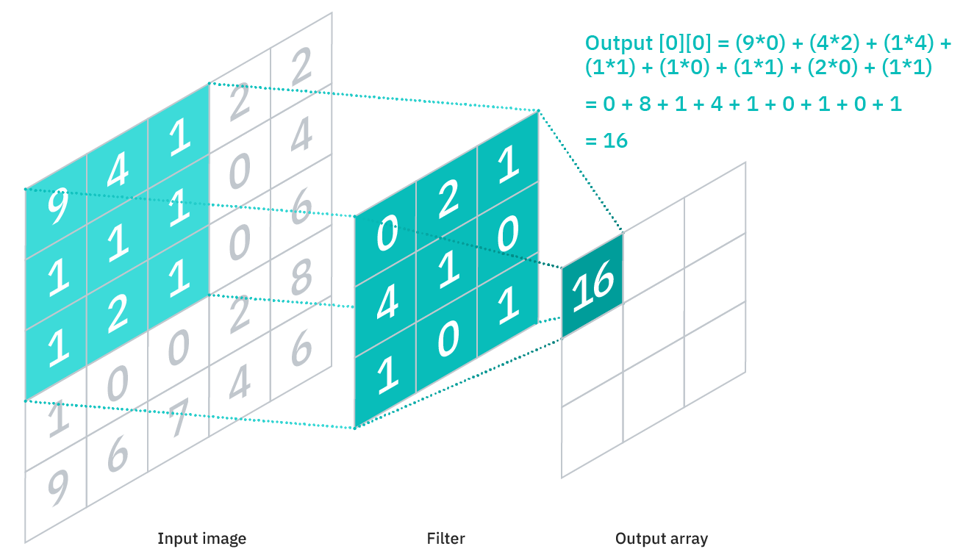
Layers of Convolutional Neural Network
Convolution Layer
Pooling Layer
Fully Connected (FC) Layer
Convolution Layer
Components
Input Image
Filter / kernel
Output array

Slide 18
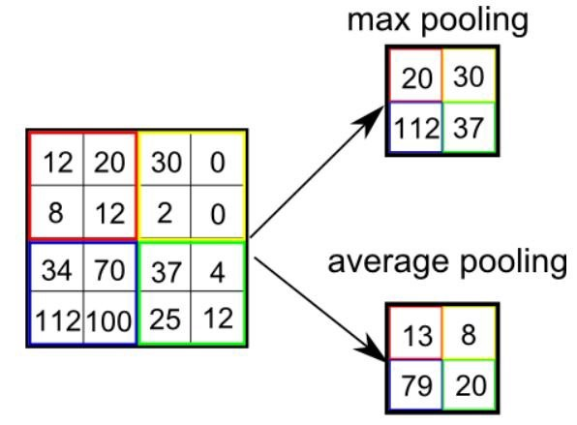
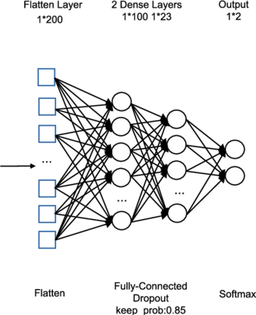
Pooling Layer
Types of pooling
Average pooling
Max pooling
Fully Connected Layer
performs classification based on the features extracted
Uses SoftMax function
Output

Slide 19
EfficientNet-B3
The EfficientNet-B3 model used has,
Around 390 layers
10,875,999 trainable parameters
87,303 non-trainable parameters
10,875,999 Total parameters.

Slide 20
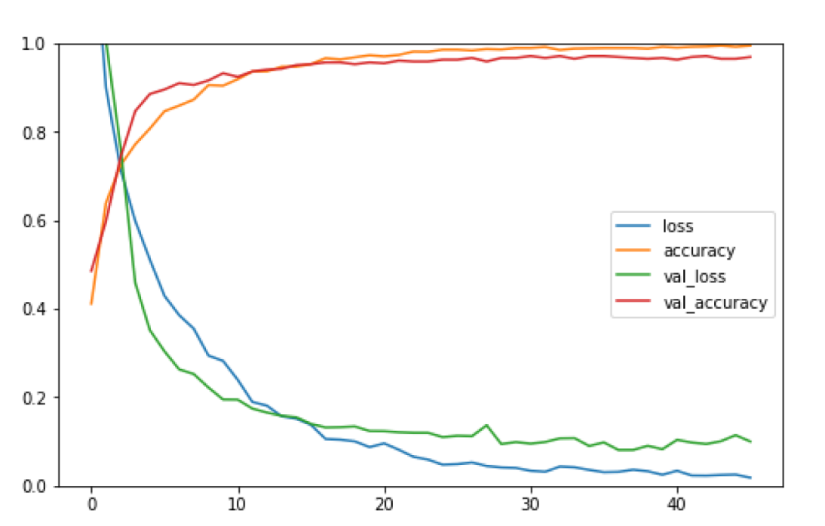
RESULT
Training Accuracy vs Loss
Value in %
No. of Epochs

Slide 21
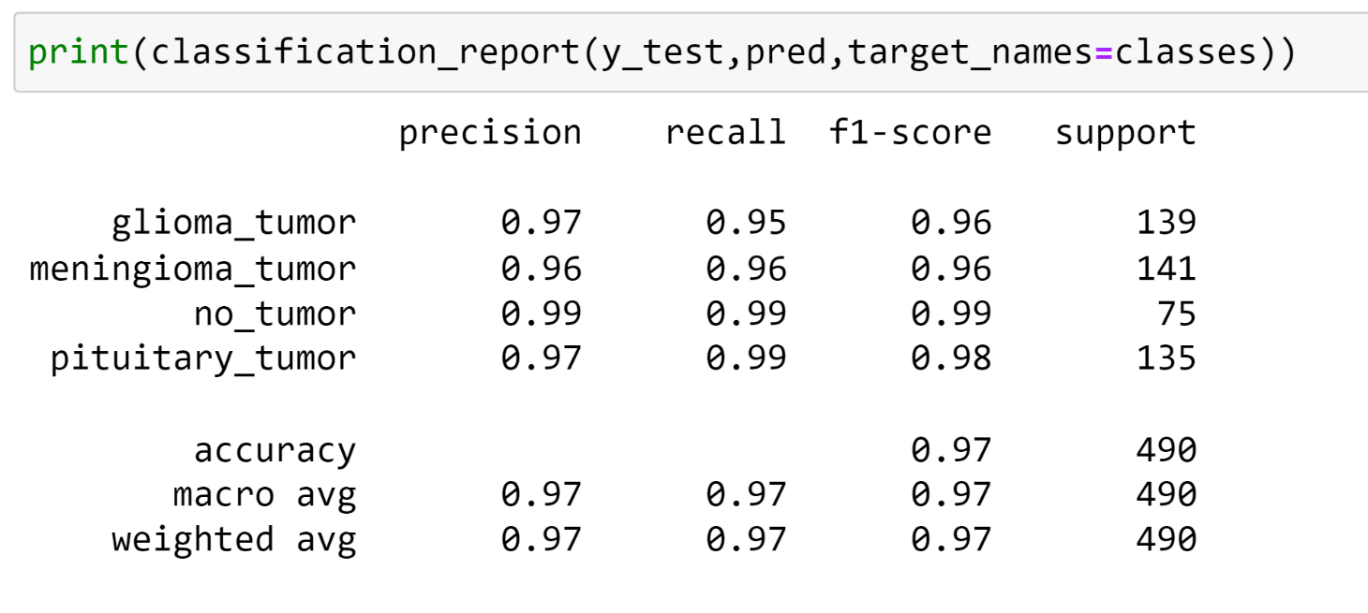
Classification report

Slide 22
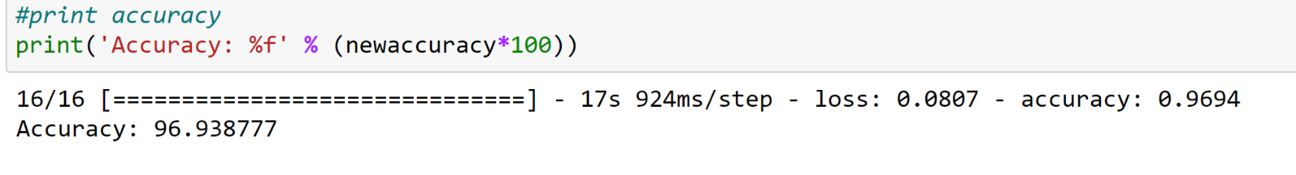
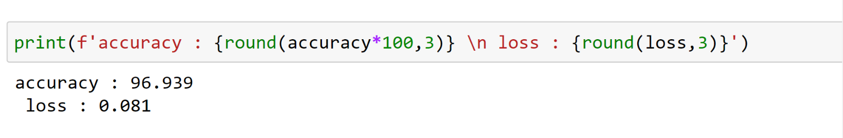
Test Accuracy

Slide 23
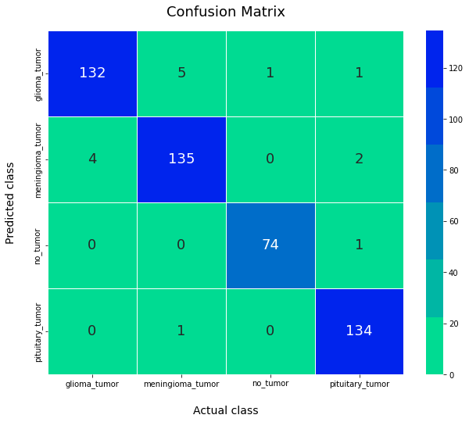

Slide 24
CONCLUSION
In this project, we have built a system which can predict brain tumor accurately using deep learning techniques.
Using Convolutional Neural Networks we can achieve higher prediction rate without equipment and propose an approach to classify the brain tumors without much need of a professionals.
A person with least knowledge about the MRI’s can get to know their status easily through our proposed system.

Slide 25
FUTURE SCOPE
The proposed algorithm must be robust enough for accurate recognition of tumor regions from MR Images.
The proposed approach can be further improvised through a cooperating weakly trained algorithms that can identify the abnormalities with a minimum training data and also self-learning algorithms would aid in enhancing the accuracy of the algorithm and reduce the computational time.

Slide 26
THANK YOU

